Slide 1
Image Warping
Prof. Eric Miller
elmiller@ece.tufts.edu
Fall 2009
EN 74-ECE Image Processing
Lecture 10-<number>

Slide 2
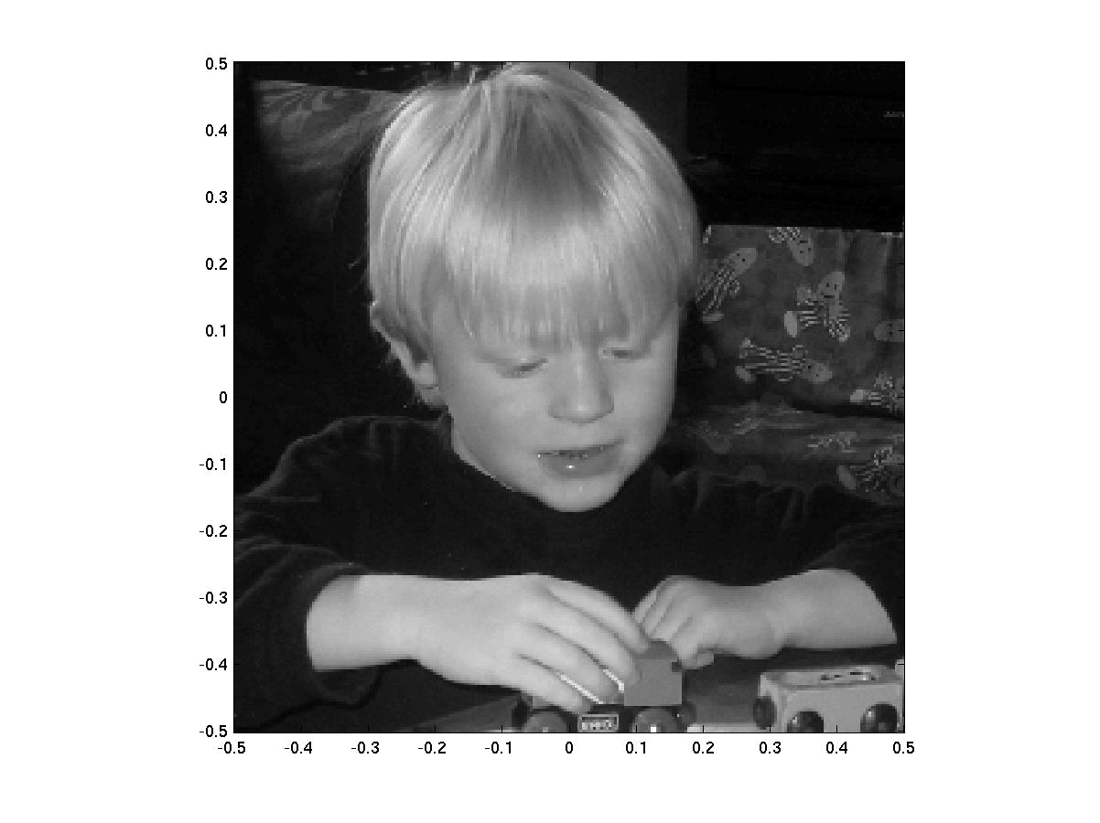
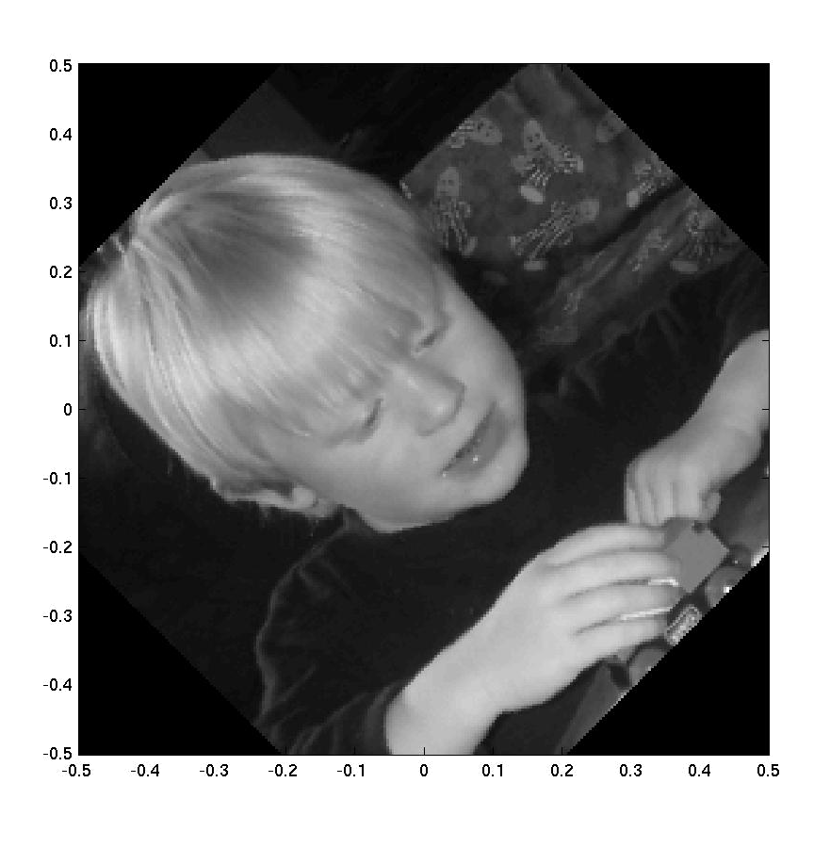
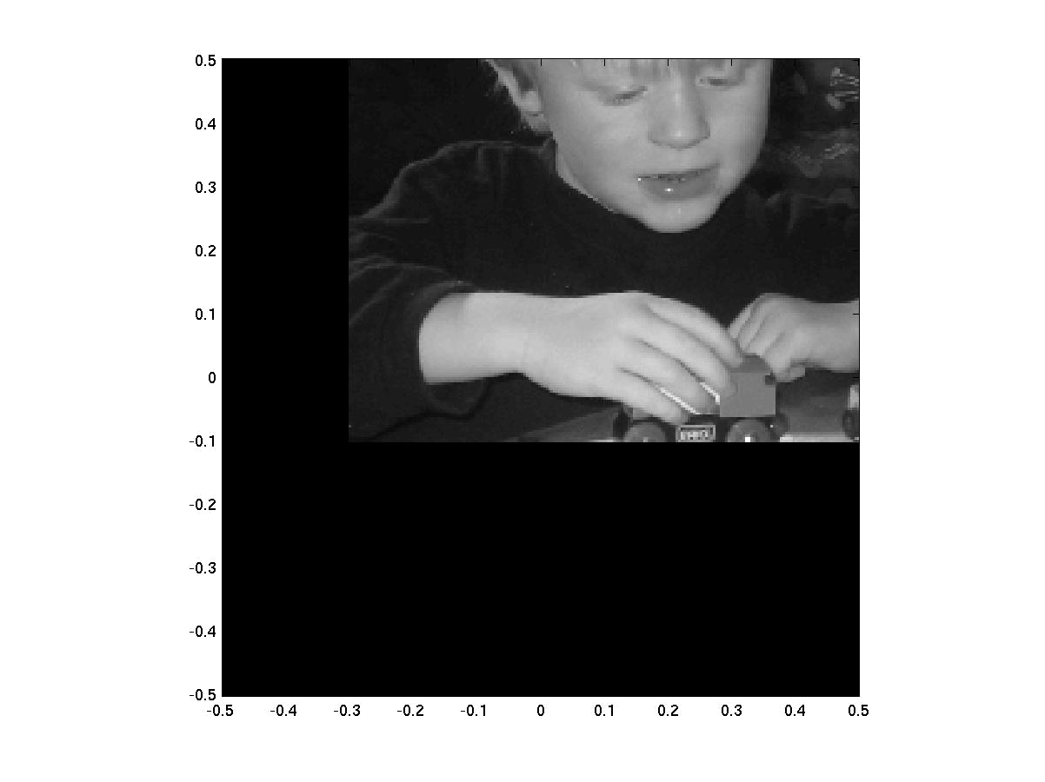
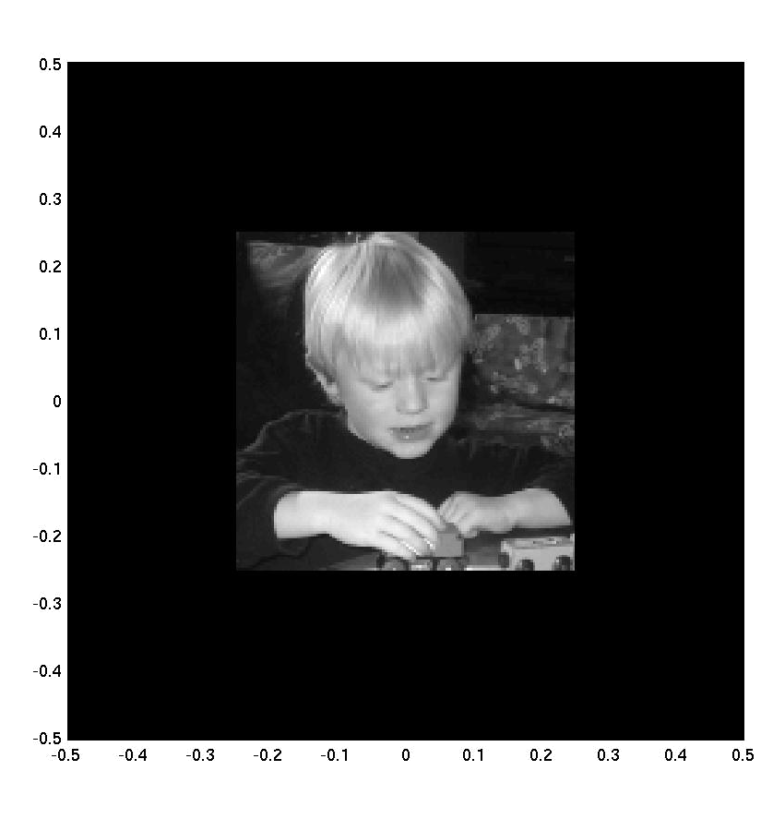
Type of thing we would like to do
Rotate
Scale
Translate
Fall 2009
EN 74-ECE Image Processing
Lecture 10-<number>

Slide 3
Overview
Seems like this should not be that hard to do
In the end it is not, but getting there takes some thought
Up to now we have been modifying the values of the pixels
Now we are going to mess with the coordinates of the pixels
Not surprisingly, this is going to take some mathematics
Fall 2009
EN 74-ECE Image Processing
Lecture 10-<number>

Slide 4
Matlab Preliminaries
From here on out I want to think of an image as a sampled version of a 2D function centered at the origin located in the “unit square” with side length = 1;
It just becomes easier to do things this way mathematically
The Matlab becomes a bit more trouble
f = imread([imbase,'engineer.tif']);
f = double(f);
[nr nc] = size(f);
x = linspace(-0.5,0.5,nc)';
y1 = linspace(-0.5,0.5,nr)';
y = flipud(y1);
figure(1);clf;colormap gray
imagesc(x,y,f);axis square;axis xy
Fall 2009
EN 74-ECE Image Processing
Lecture 10-<number>

Slide 5



Translation
f(x,y)
g(x,y)
(p,q)
(x,y)
Basically, p and q define a new coordinate system for the image
Image g is equal to image f evaluated in this new coordinate system
Fall 2009
EN 74-ECE Image Processing
Lecture 10-<number>

Slide 6
Doing this in Matlab
Build x and y arrays as before
    x = linspace(-0.5,0.5,nc)';
    y1 = linspace(-0.5,0.5,nr)';
    y = flipud(y1);
Use meshgrid to get all (x,y) pairs
[X,Y] = meshgrid(x,y);
Find all (p,q) pairs using the formula
    P = X-0.2;
    Q = Y-0.4;
Find g using interpolation
g = interp2(X,Y,f,P,Q,'linear',0);
Display using good old (x,y) coordinates
    imagesc(x,y,g);colormap gray
    axis square ; axis xy
Fall 2009
EN 74-ECE Image Processing
Lecture 10-<number>

Slide 7
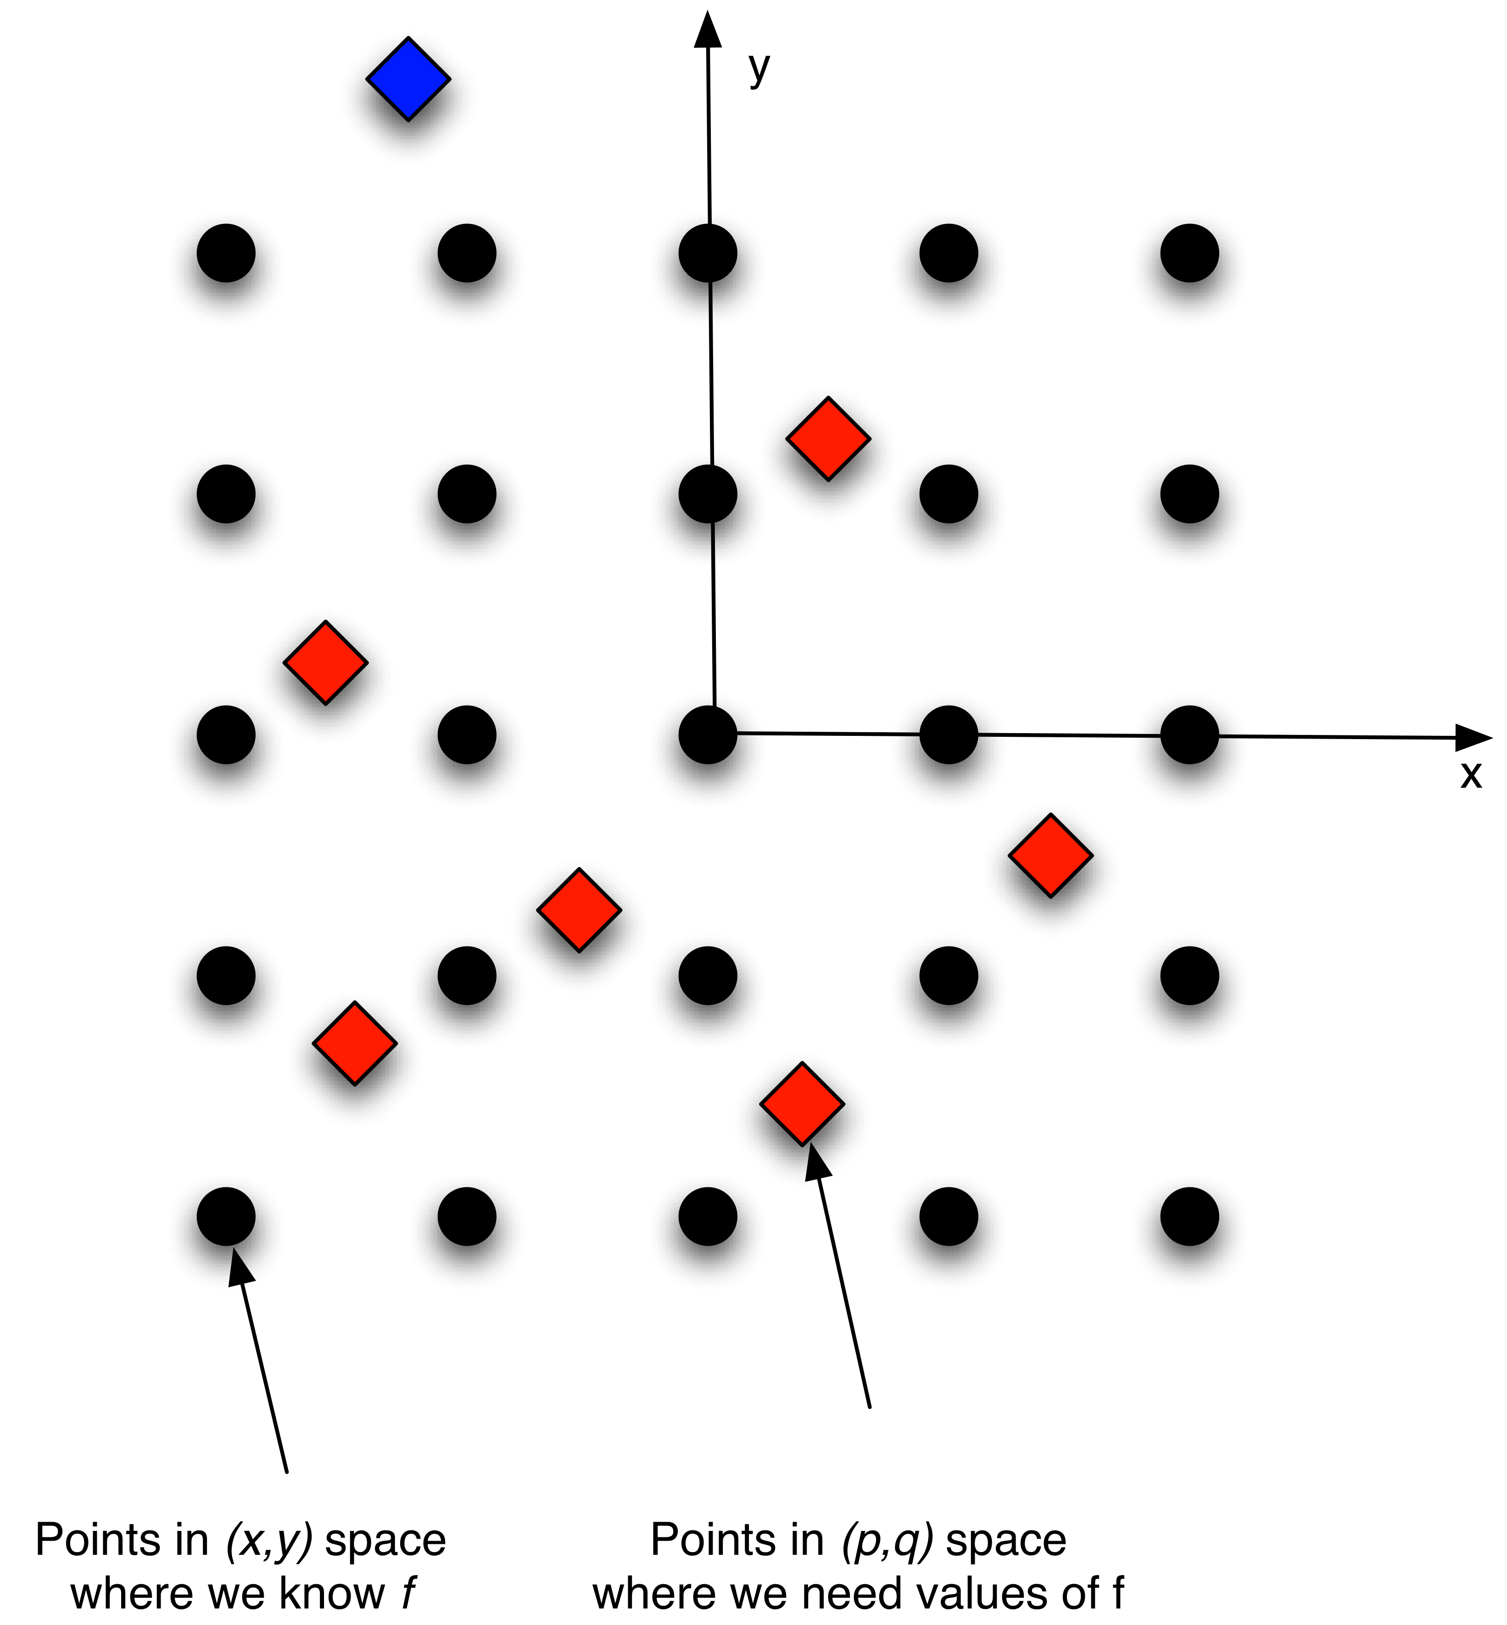
A Bit on Interpolation
When we compute all the (p,q) pairs where we want to find f, odds are they will not correspond to places where we already know f
Interpolation = procedure for taking the data where we know it and getting values for f where we need it
Most basic forms:
  Data at diamond = value of f at closest circle
  Data at diamond = average of close by f’s
Fall 2009
EN 74-ECE Image Processing
Lecture 10-<number>

Slide 8
Matlab Interpolation
Original coordinates built using meshgrid
New coordinates built from meshgrid-ed X and Y
g = interp2(X,Y,f,P,Q,'linear',0);
Input image
Value to use for g for diamonds outside of tabulated values for (x,y) (blue diamond on previous slide.)
Interpolation method: nearest, linear, cubic
Fall 2009
EN 74-ECE Image Processing
Lecture 10-<number>

Slide 9
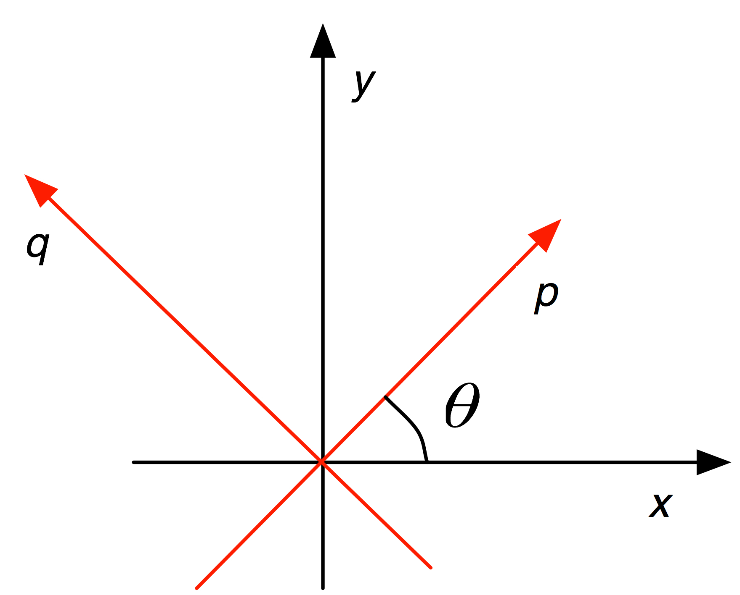




Rotation Transformation
Does this check?
Fall 2009
EN 74-ECE Image Processing
Lecture 10-<number>

Slide 10
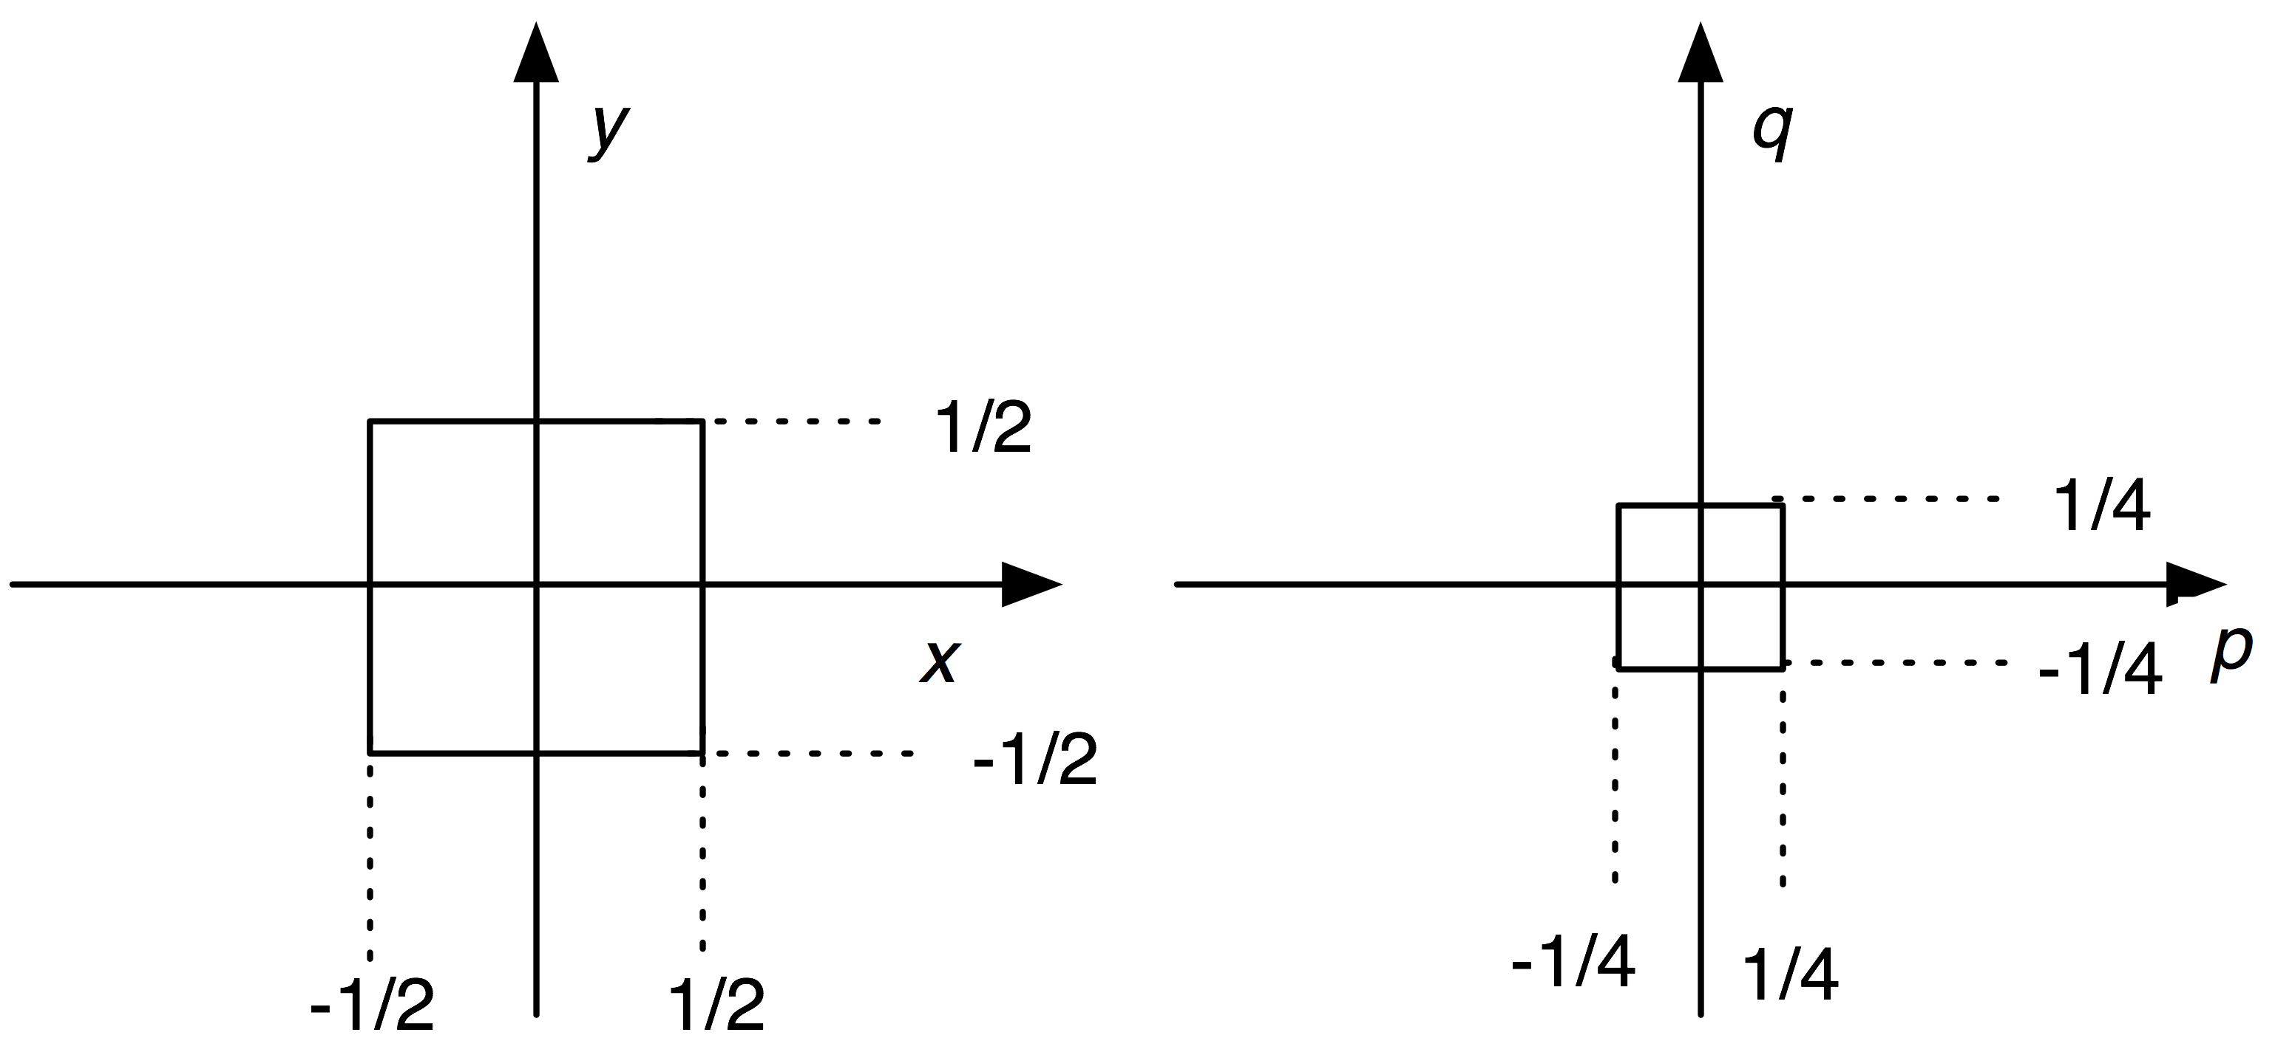





Uniform Scaling
Scale by a factor of s>0
Does this check?
So we shrink the square
Fall 2009
EN 74-ECE Image Processing
Lecture 10-<number>

Slide 11
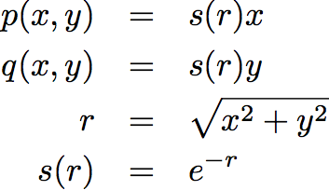
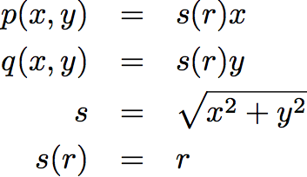
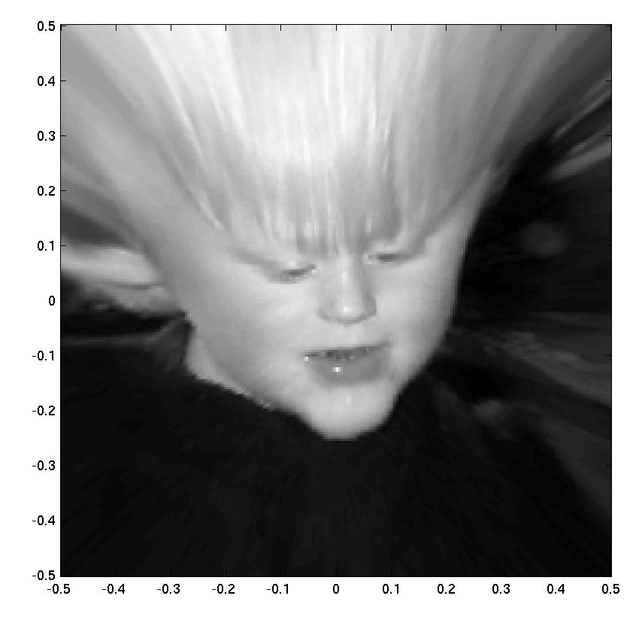
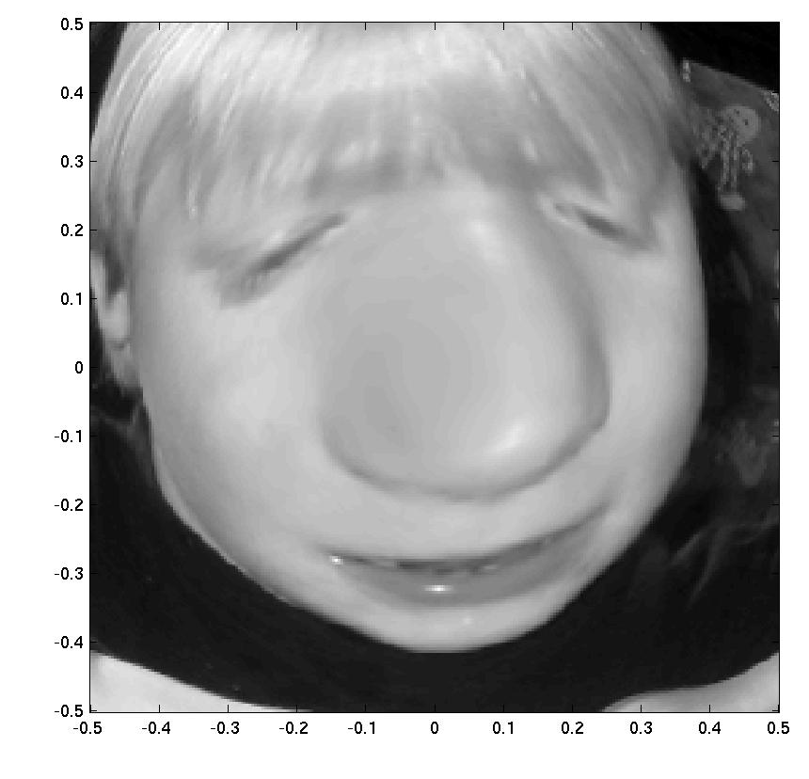
Nonuniform scaling
Less stretch near origin and more further away?
More stretch near origin and lessfurther away?
Fall 2009
EN 74-ECE Image Processing
Lecture 10-<number>

Slide 12
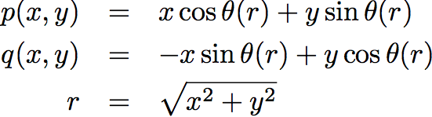


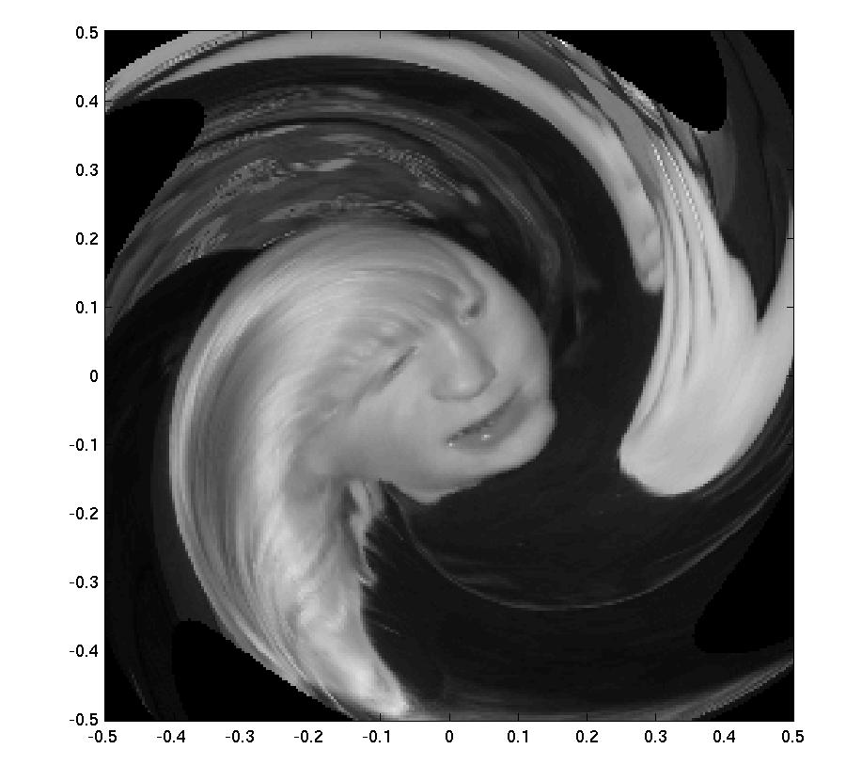
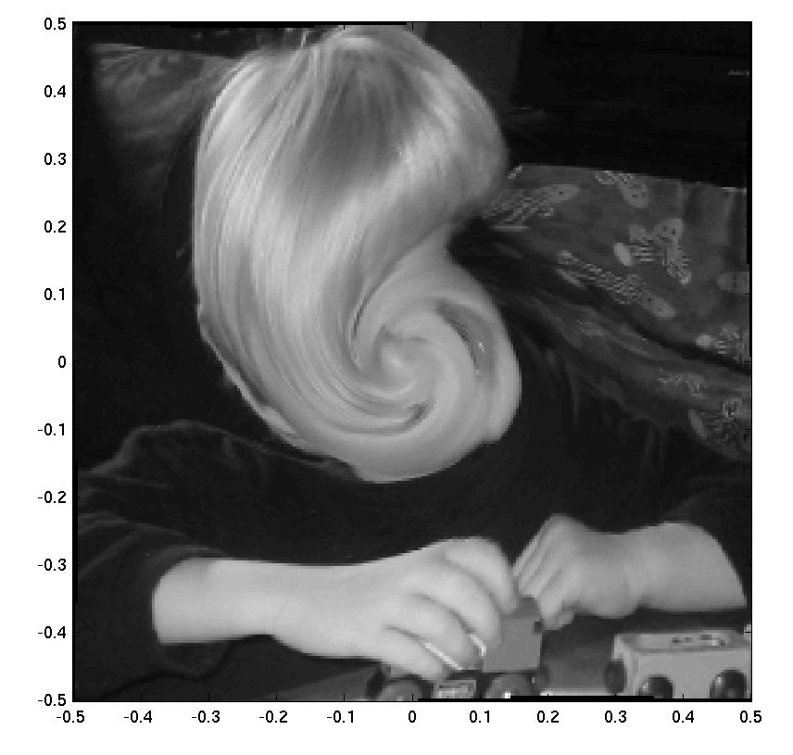
Nonuniform Rotation
Fall 2009
EN 74-ECE Image Processing
Lecture 10-<number>

Slide 13
Matlab Topics Covered
Use of meshgrid to generate point pairs
Use of interp2 as a tool for evaluating functions where we do not have samples (i.e., interpolating functions)
Fall 2009
EN 74-ECE Image Processing
Lecture 10-<number>

